Slide 1


Slide 2

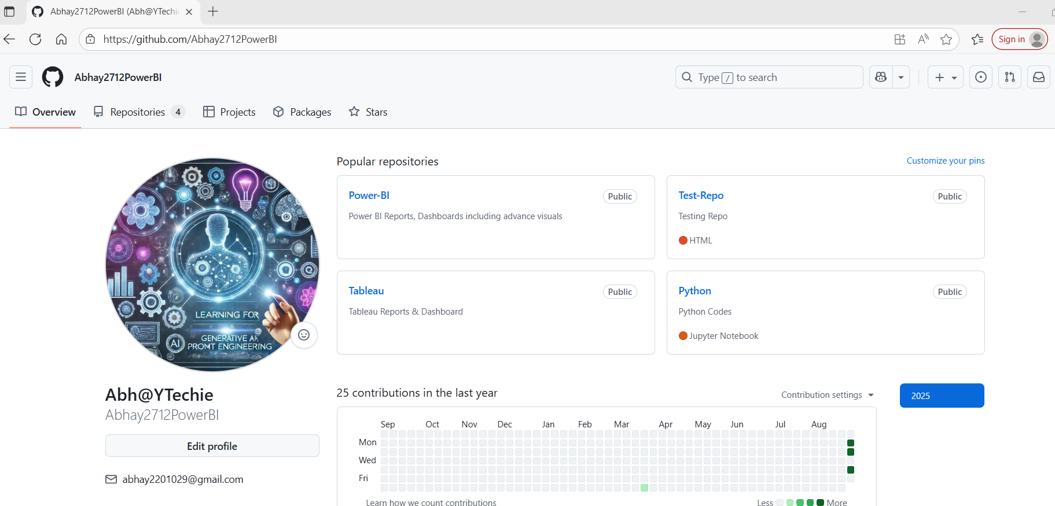
GitHub is a cloud-based platform that hosts Git repositories.
Think of it like Google Drive for Git projects, but with collaboration features.
It adds features on top of Git like:
Remote repositories (store your project online)
Collaboration (multiple developers working together)
Pull requests & code reviews
Issue tracking
Actions/CI-CD pipelines
Alternatives: GitLab, Bitbucket, Azure Repos
Example:
You push your local Git repo to GitHub → teammates can clone it, work on it, and send pull requests.

Slide 3
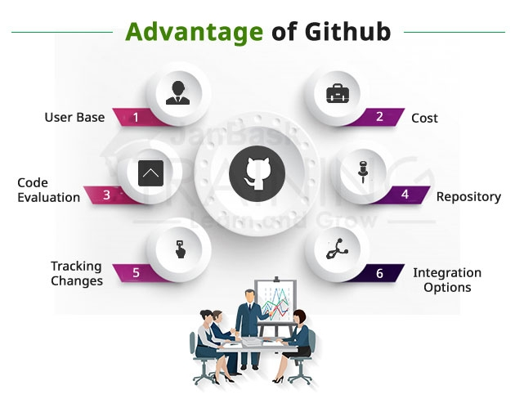
GitHub is a website that hosts Git repositories online.
Developers upload their project code on GitHub to share, collaborate, and showcase their work.
GitHub repositories (repos) are like folders containing all project files and history.
GitHub profiles can be linked in resumes to verify and demonstrate coding projects.
Users can create new repositories, set them public or private, and manage project files directly on GitHub.

Slide 4


Slide 5
Creating an account is free and straightforward.
Go to the Website: Navigate to github.com in your web browser.
Sign Up: You will see a form to create your account.
Enter your email address. (Use a personal email you have access to).
Create a secure password.
Choose a username. This will be your public identity on GitHub (e.g., github.com/yourusername). Choose something professional if you plan to use it for work.
Verify Your Account: You will be asked to solve a simple puzzle to verify you are not a robot.
Optional: Tailored Experience: GitHub may ask if you want to receive product updates and recommendations. You can choose yes or no.
Verify Your Email: GitHub will send a verification code to the email address you provided. Enter this code on the website to complete the setup.
Welcome! Your account is now active. You can start exploring.
The free plan is excellent for most individuals and includes unlimited public repositories and unlimited private repositories (with a limit on the number of collaborators).

Slide 6
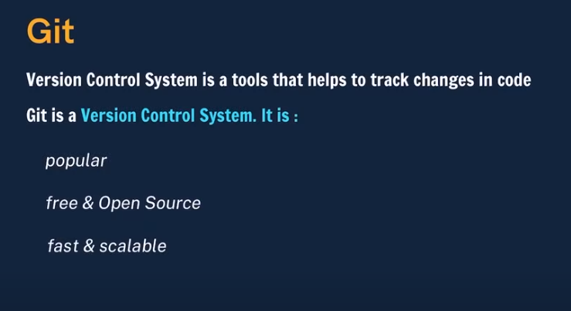
GitHub is a website that hosts Git repositories online.
- Developers upload their project code on GitHub to share, collaborate, and showcase their work.
- GitHub repositories (repos) are like folders containing all project files and history.
- GitHub profiles can be linked in resumes to verify and demonstrate coding projects.
- Users can create new repositories, set them public or private, and manage project files directly on GitHub.

Slide 7
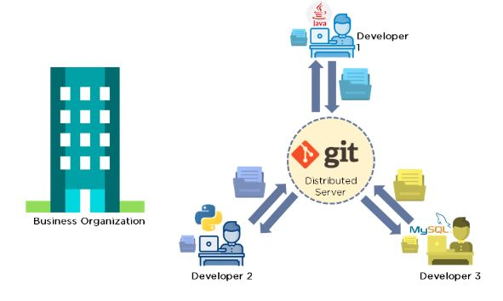
Git is a version control system that tracks changes in code over time, similar to a bank statement that logs transactions.
- It records additions, deletions, and modifications to files, enabling developers to revert to previous states.
- Git helps manage code changes efficiently, especially in large projects.
- Git is free, open-source, fast, and scalable, making it suitable for projects of any size.

Slide 8


Slide 9
GIT Assignment
● Create a new folder
● Put the following files in the folder
○ Code.txt
○ Log.txt
○ Output.txt
● Stage the Code.txt and Output.txt files
● Commit them
● And Finally push them to GitHub

